Slide 1
Web development
Student:
Teacher:My dear great teacher

Slide 2
agenda
Web programming
XAMPP:Web server and database
HTML programming
CSS
JAVAscript
My funny web site

Slide 3
xampp

Slide 4
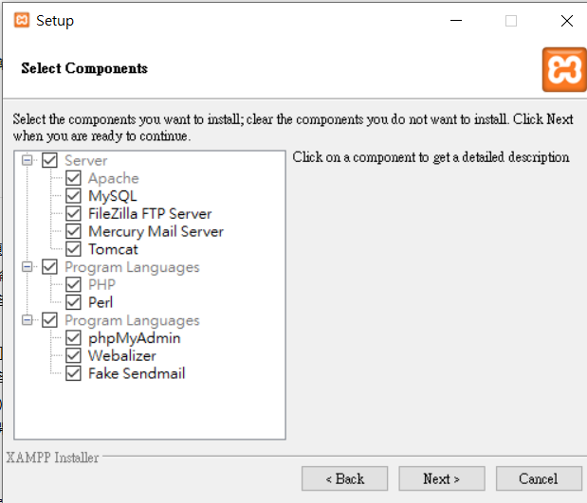

Slide 5
https://en.wikipedia.org/wiki/Webalizer

Slide 6
phpMyAdmin is a free software tool written in PHP
A web interface for MySQL and MariaDB.
https://docs.phpmyadmin.net/,

Slide 7
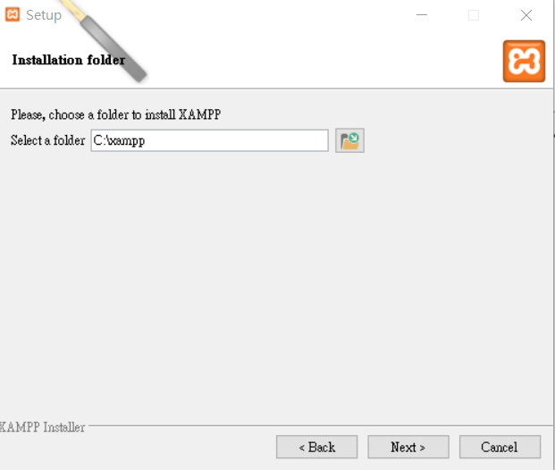

Slide 8
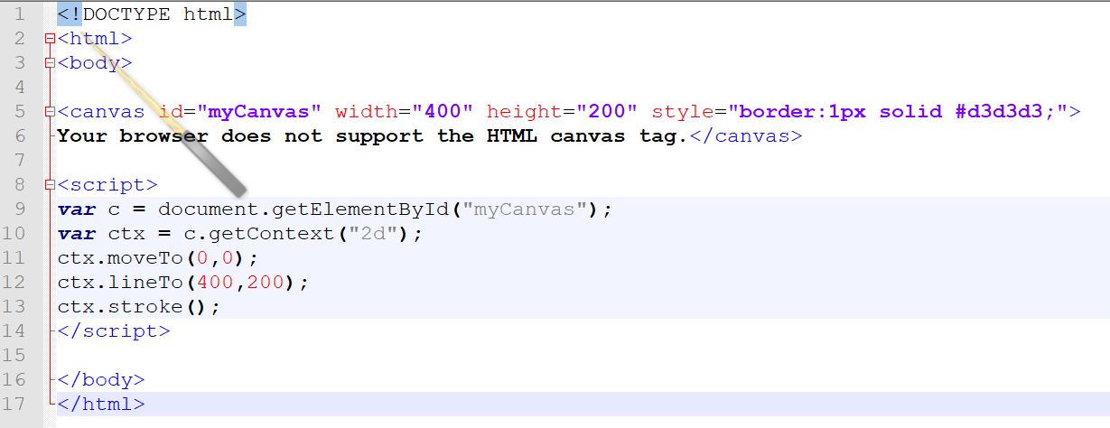
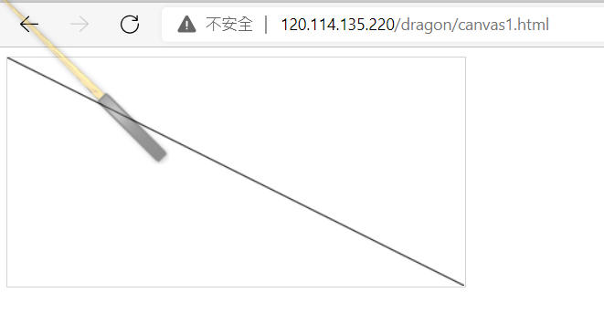

Slide 9
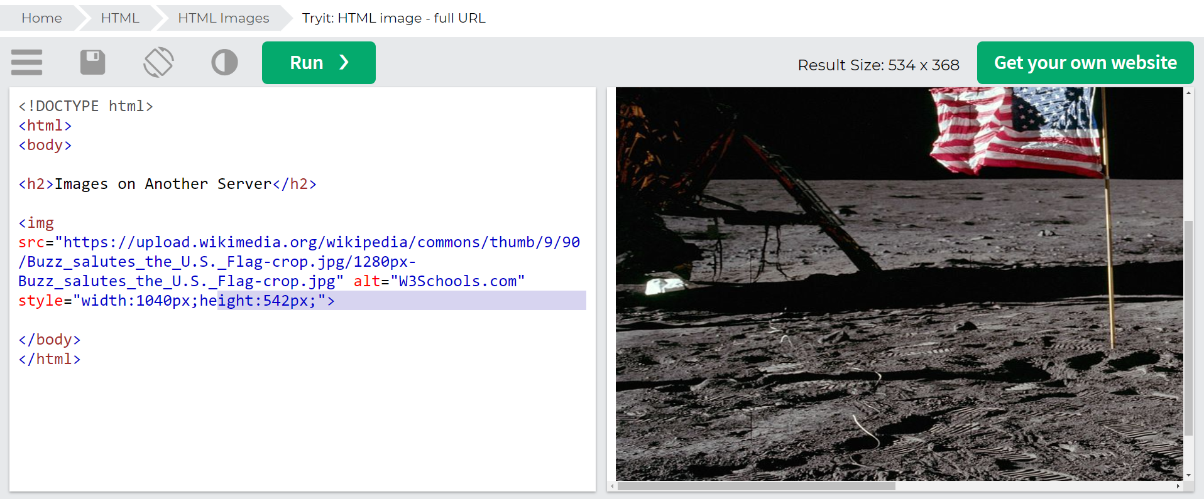
https://www.w3schools.com/html/tryit.asp?filename=tryhtml_images_w3schools

